Slide 1
Other Income
Pub 4012 – Tab D
Pub 4491 – Lesson 16
Notes:
Release 2 Slide changes:
Slide 3 – updated screen shot
Slide 7 – Added example
Slide 9 – Changed first bullet from greater than $600 to $600 or more
The first slides cover the core material for Other Income
There are many more slides than are needed for Instructors to present this tax topic. Instructors should choose those slides necessary to prompt discussion depending on the experience level of their volunteers
Key Slides for new Volunteers include: 2, 3, and 8-14
For returning volunteers only slides 2 and 3 may be needed to prompt discussion
This slide set can also be a good review resource for those certifying through self-study
The following comprehensive topics for Other Income are at the end of the presentation:
Long Term Care (LTC) Payments Slides 20-24
Refer to other presentations for:
Other Compensation -- see Wages NTTC Slide Set 11
Medical Waiver Payments -- See NTTC Slide Set 24

Slide 2
Other Income
Pub 4012 Tab D
Review the Other Income page in Pub 4012 Tab D
Income that is not included elsewhere in the return
May or may not have a tax document or form
Often self-reported by the taxpayer
Review the Tax-Aide Scope Manual – Note in and out of scope items
Scope Manual
Notes:
Instructors should direct the volunteers to open the Volunteer Resource Guide (Pub 4012) to TAB D and review the information.
Instructors should direct the volunteers to review the Tax-Aide Scope Manual. It is recommended that the electronic version of the Scope Manual be available as a link on all classroom computers. If not available Instructor can use the next slide.
The next few slides reinforce that information.
Some Other Income is straightforward since the taxpayer has a tax document such as a 1099-MISC or W-2G. However often there is no document for the income such as jury duty or poll worker pay. In some cases W-2Gs are not generated unless the winnings reach a minimum threshold.

Slide 3
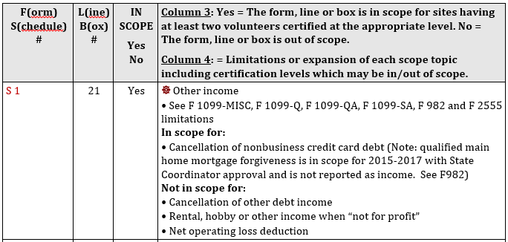
Tax-Aide Scope Manual
Notes:
Instructors can use this slide if the electronic version of the scope manual is not available to the volunteers in the classroom.

Slide 4
In-Scope Examples
Reported on 1099-MISC, Box 3
Reported on 1099-MISC, Box 7 – but “not a business”
Gambling winnings including lotteries and raffles
Taxable amount of long term care (1099-LTC)
Cancellation of nonbusiness credit card debt
Other examples: jury duty pay and poll worker pay (not on W-2), prizes and awards, medical study subject pay
Notes:
Income from all sources must be reported, unless specifically excludible
Includes:
Illegal activities, such as money from dealing illegal drugs, must be included in your income on Form 1040 or on Schedule C if from your self-employment activity (illegal income is out of scope)
A free tour from a travel agency for organizing a group of tourists must be included as income
Refund or reimbursement of an item deducted in an earlier year (Form 1040) must generally be included as income in the year received, subject to the tax benefit rule
Whether or not reported on Form 1099-MISC
Form 2555 exclusion of foreign earned income is in scope with International certification only

Slide 5
Out-of-Scope Examples
Bartering income
Activity not entered into for profit (e.g Hobby income)
Cancelation of debt other than nonbusiness credit cards
Cancelation of debt on main home (Unless Extended)
Taxable distributions from Education Savings or ABLE accounts

Slide 6
Other Income
Do NOT include 1099-MISC income that is business income
Report on Schedule C
Do NOT include rent or royalty income
Report on Schedule E or on Schedule C if in scope
Do NOT include compensation for wrongful incarceration
Do NOT included household employee income under $2,000
Report as wage income on Form 1040
Notes:
If the taxpayer receives less than $2,000 and is properly considered a household employee, the income may be reported as household employee income – see Income – Wages slide deck #12
A “wrongfully incarcerated individual” is either:
1) An individual who was convicted of a criminal offense under federal or state law, who served all or part of a sentence of imprisonment relating to such offense, and who was pardoned, granted clemency, or granted amnesty because of actual innocence of the offense, or
2) An individual for whom the conviction for such offense was reversed or vacated and for whom the indictment, information, or other accusatory instrument for such offense was dismissed or who was found not guilty at a new trial after the conviction was reversed or vacated
This PATH provision applies to tax years beginning before, on, or after the date of enactment
Note: claims for 2012 and prior had to be filed by December 19, 2016 – special exception to statute of limitations for this compensation
If improperly reported on 1099, enter and remove with a negative offsetting other income amount
Amended return needed for prior year if included in taxable income

Slide 7
Intake/Interview
Review the Intake and Interview (I&I) Sheet
Part III Question #15: Other Income
Part V Question #2: Cancellation of Debt
There may not be a tax document (e.g. Jury Duty Pay)
Must ask probing questions to determine the source and amount of the income
Always ask “Did you have any other income?”

Slide 8
Other Income Tax Forms
Form 1099-MISC Box 3 Other Income
Form 1099-MISC Box 7 – Not a business
Form W-2G Gambling Winnings
Form 1099-C Cancellation of Debt
Forms 1099-Q and 1099-QA Distributions from Education Savings Plans
Form 1099-LTC Long Term Care Payments
Notes:
Instructors need to discuss the 1099-MISC as sometime box 3 reports other income when in fact the taxpayer performed work or services and it should be business income. Conversely, sometimes box 7 reports non-employee compensation when in fact the taxpayer was not conducting a business. See NTTC Training Slide Set 27 1099-MISC for more information – Instructors may want to add selected slides from that presentation to clarify the box 3/box 7 issue.
See the Scope Manual for Forms 1099-Q and 1099-QA if there is a taxable amount – out of scope

Slide 9
Form 1099-MISC
Box 3 Other Income (Required if income $600 or more)
Prizes and Awards
Sweepstakes (no wagers involved)
Medical research studies
Honorarium

Slide 10
Form 1099-MISC
Box 7 Non-employee Compensation
Report as other income if not a business
Examples of Income | Direct to:
Non-Employee Compensation that is not really a business such as an honorarium for a speech where there is no continuing relationship and no expectation of ever doing it again. | Box 3 | Line 21
Non-Employee Compensation that is normally a business | Box 7 | Schedule C
Notes:
See NTTC Slide Set 25 Income Form 1099-MISC for more information.

Slide 11
Gambling Winnings
Normally reported on W-2G depending on:
the type of gambling,
the amount of the gambling winnings, and
Generally, the ratio of the winnings to the wager
Gambling losses may be deducted on Schedule A up to amount of winnings
Notes:
Note some taxpayers believe they can deduct losses up front. Losses can only be deducted if taxpayer itemizes

Slide 12
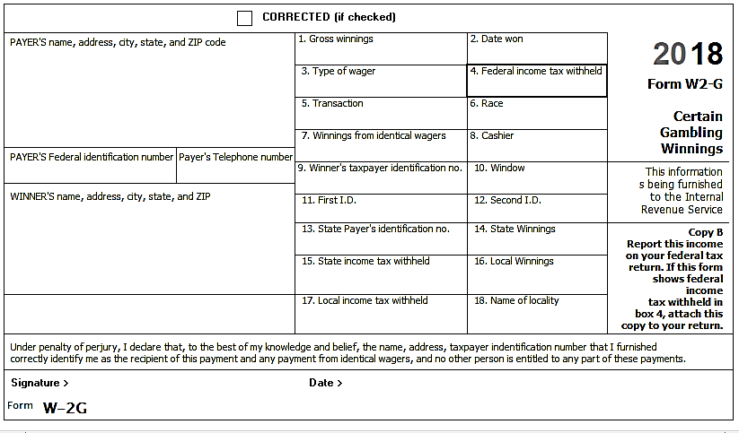
Form W-2G
Notes:
This is Form W-2G from the forms section of irs.gov. However, many gambling establishments have their own form. Many times they are filled in by hand. The taxpayer may even receive a carbon copy which can often be hard to read.
This IRS example is provided to show the type of information that is often reported.

Slide 13
Cancellation of Debt
Pub 4012 Tab D
Only cancellation of nonbusiness credit card debt is in scope
Reported on Form 1099-C if over $600
Review Pub 4012 Tab D Cancellation of Debt section
Review the screening sheet
Note issues that are out of scope, e.g. bankruptcy
Notes:
If a taxpayer has other types of debt cancelled (car loans and student loans are most common) refer them to a paid preparer

Slide 14
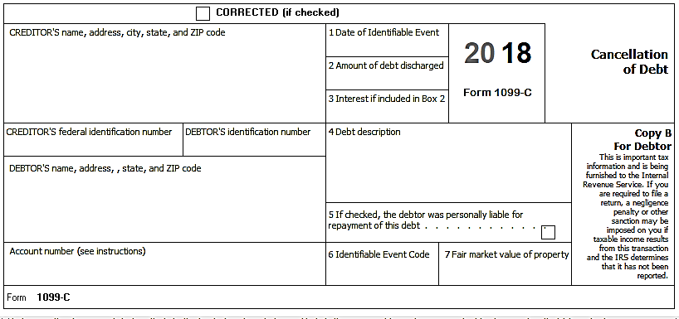
Form 1099-C
In box 2
Credit card debt only if nonbusiness
Code A is Bankruptcy and out of scope
Notes:
An amount in box 3 can be ignored as it is included in box 2
Because only nonbusiness credit card debt is in scope, any interest forgiven is also income.
Bankruptcy is out of scope

Slide 15
Entering Other Income in TaxSlayer
Go to Pub 4012 Tab O Navigating TaxSlayer:
1099-MISC box 3 or box 7 (not a business)*
W-2G Gambling Winnings
Other Income for everything else
Review Pub 4012 Tab D Other Income section for more information
* Note – If Form 1099-MISC reports income in Box 7 and the taxpayer is not engaged in a business then the income should be entered as “Other Income” – but hobby income is out of scope
Notes:
Instructors should stress the use of Pub 4012 Tab O.
Volunteers can find the tax item that needs to be entered in the return and choose whichever navigation method they are most comfortable with:
Enter the Form Number in the box at the top on the menu section
Use the Menu Section and follow Tab O (e.g. Income>Other Income>Gambling Winnings)
Click through Summary Print
Note that TaxSlayer does not always allow information entered for a Form 1099-MISC to flow to the correct place in the return
If a 1099-MISC has an entry in Box 7 Non-Employee Compensation and the interview determines that the taxpayer was not conducting a business, then the income needs to go to “Other Income” in the return and not be subject to unemployment tax
In this case, the IRS has stated to enter the income where it should go in the return. That is enter it as though it was in Box 3
See NTTC Slide Set #27 Income Form 1099-MISC for more information

Slide 16
Other Income Not Reported Elsewhere
Used for income with no tax document
Usually self-reported and may have a letter or check stub with information
Examples:
Jury Duty pay
Poll Workers (No W-2)
Prizes, awards, honorarium (No 1099-MISC)
Notes:
Probing questions are usually required to find this income. Note that Poll Workers will usually receive a W-2 if income is over $600.

Slide 17
Income – Quality Review
The final question with respect to income to always ask the taxpayer:
Did you have any other income?
Notes:
Remember, all income is taxable (unless the law says it’s not)

Slide 18
Other Income
Comments
Questions

Slide 19
Long-Term Care Payments
Comprehensive Topic
Notes:
LTC payments are not often seen
All Counselors should have a basic awareness of the topic
Experienced Counselors should be well versed

Slide 20
Long Term Care Payments
Reported to taxpayer on Form 1099-LTC
Complete Form 8853, Section C
Sections A and B are out-of-scope
Notes:
Must enter taxpayer separately from spouse, if both are receiving LTC benefits

Slide 21
Long Term Care Payments
LTC Insurance Contracts
Generally, reimbursements are not taxable (reimbursements do not normally exceed actual costs)
Per diem reimbursements up to an aggregate limit of $360/day (2018) are non-taxable
If there are multiple payees under the insurance contract, refer the taxpayer to a paid preparer

Slide 22
Accelerated Death Benefits
Insured is certified by a physician as terminally ill
Fully excludible
Certified as chronically ill
Treated the same as paid under a qualified long-term care insurance contract

Slide 23
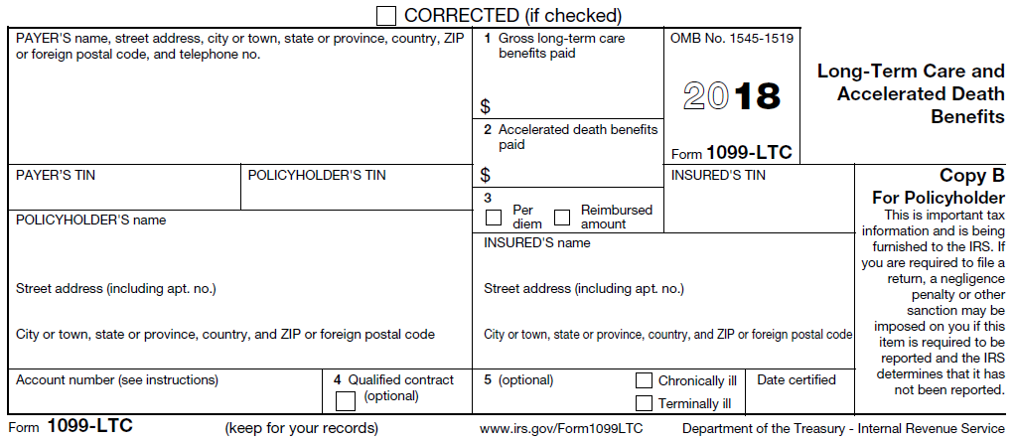
Long Term Care Payments Form 1099-LTC
Notes:
Review form contents
Gross paid
Whether per diem or reimbursed actual
Qualified contract (not required)
Whether chronically or terminally ill

Slide 24
Form 8853 LTC
Find Other Income in Pub 4012 Tab D, very bottom of page for TaxSlayer entries
Complete Form 8853
Usually, none is taxable

